Slide 1
How to Win a Game?
Mhariadora Bocalbos

Slide 2
Objective
Predict whether a game is going to be a win or a lose
Find most important features that will determine whether it is a win or a lose
Determine how these features influence whether the game is going to be a win or a lose

Slide 3
The Dataset
Play by play NBA dataset for 12 seasons (2006-2017)
Aggregated data to have statistics per game.
Target variable: whether home team is going to win (1) or lose (0)
Feature variables: away score, away team, home team, number of blocks, shots made, shots missed, turnover, highest score by a player, number of players with greater than 10 points, number of assists, freethrow within last 2 mins, freethrow total, freethrow percentage, score difference within the last 2 mins, and field goal percentage

Slide 4
Machine Learning: Random Forest
Tuning hyperparameters: number of features, number of estimators (trees), number of leaves (nodes)
Half of the features, 25 trees, 24 leaves
Train and fit model using optimized hyperparameters
Got a score of 0.69 which is good enough
Got top 5 most important feature: away score, shots made, field goal percentage, free throw total, number of blocks

Slide 5

Machine Learning: Random Forest
Retrained model using the top 5 features
Got a score of 0.68 which is only a .01 drop from previous score meaning these 5 features can be good predictors of our target variable

Slide 6
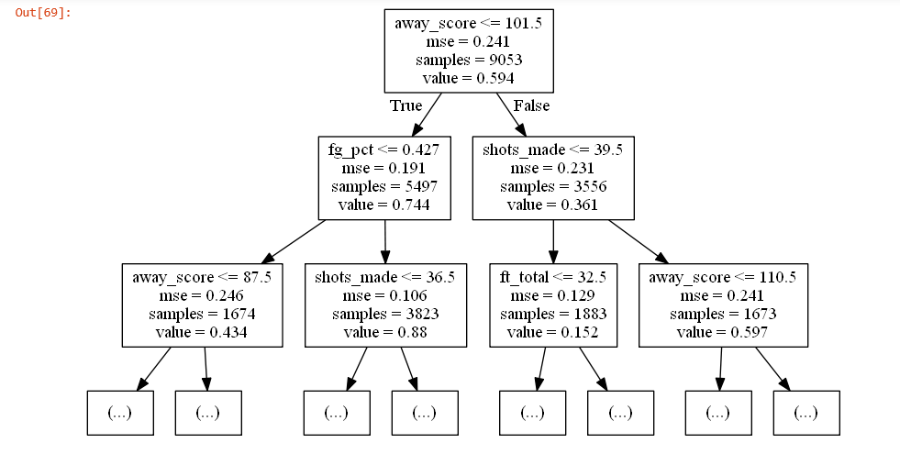
Decision Tree to Visualize

Slide 7
THANK YOU!

